Slide 1


OpenVLA: An Open-Source Vision-Language-Action Model
Kim, M. J., Pertsch, K., Karamcheti, S., Xiao, T., Balakrishna, A., Nair, S., ... & Finn, C. (2024). OpenVLA: An Open-Source Vision-Language-Action Model. arXiv preprint arXiv:2406.09246.
Notes:
ご紹介いただきありがとうございます．
はい，では早速ですが，いまから私が時間を稼ぐのでこのQRコードからスライド資料をゲットしてください．
わたし昨日世界モデルのセッションを聴講していたんですが，ごりごりの世界モデル発表があって，いま僕のテーマが場違い感すごいかもしれないと思って震えています．
そう，そもそも朝ですし，みなさんもう3つも発表を乗り越えていることもあるので，聞いてくれる人がいるかかなり心配でめちゃめちゃ緊張しているんですが，そろそろ時間を稼げたと思うので，発表をしていこうと思います．よろしくお願いいたします．

Slide 2
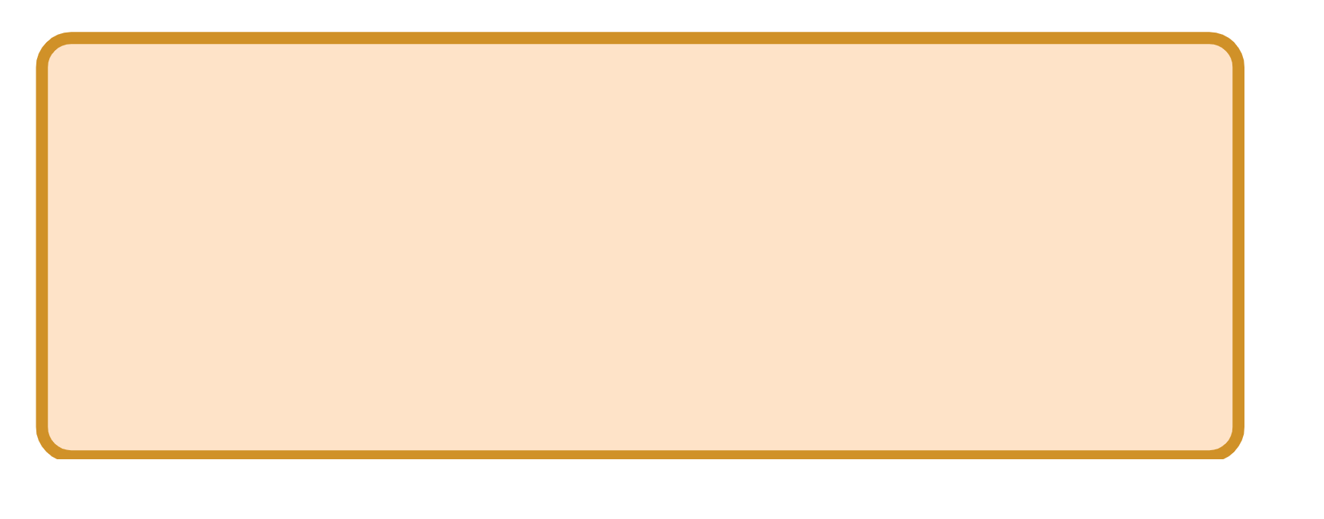
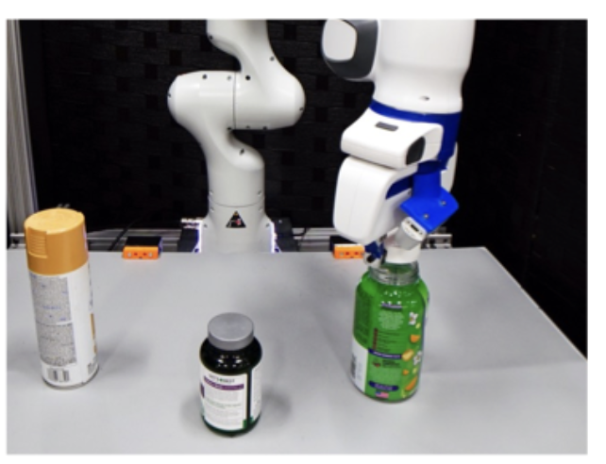
Background : Robotic Manipulation with Open-Vocabulary Instruction
Robotic Manipulation : Robots controlling objects to perform tasks
Robotic Manipulation has different applications :
Turn open the vitamin bottle
Human-robot collaboration [Wang+, CoRL21]
Cooking [Shi+, CoRL23]
Household service [Tyree+, IROS22]
→ Robotic Manipulation could be extremely useful
Need for effective models

Slide 3
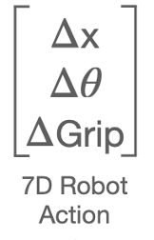
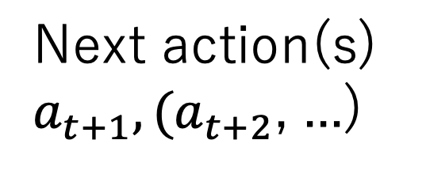
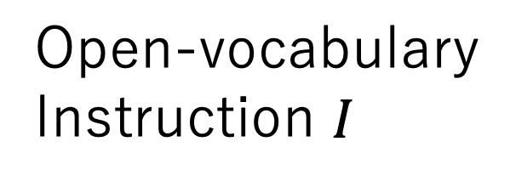
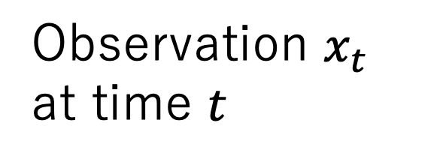
Problem Statement : From Open-vocabulary instruction and observations to actions
Multi-modal Robotic ManipulationModel
Next action(s) $a_{t+1}, {(a}_{t+2}$, ...)
Observation $x_{t}$ at time $t$
Turn open the vitamin bottle
Open-vocabulary Instruction $I$

Slide 4
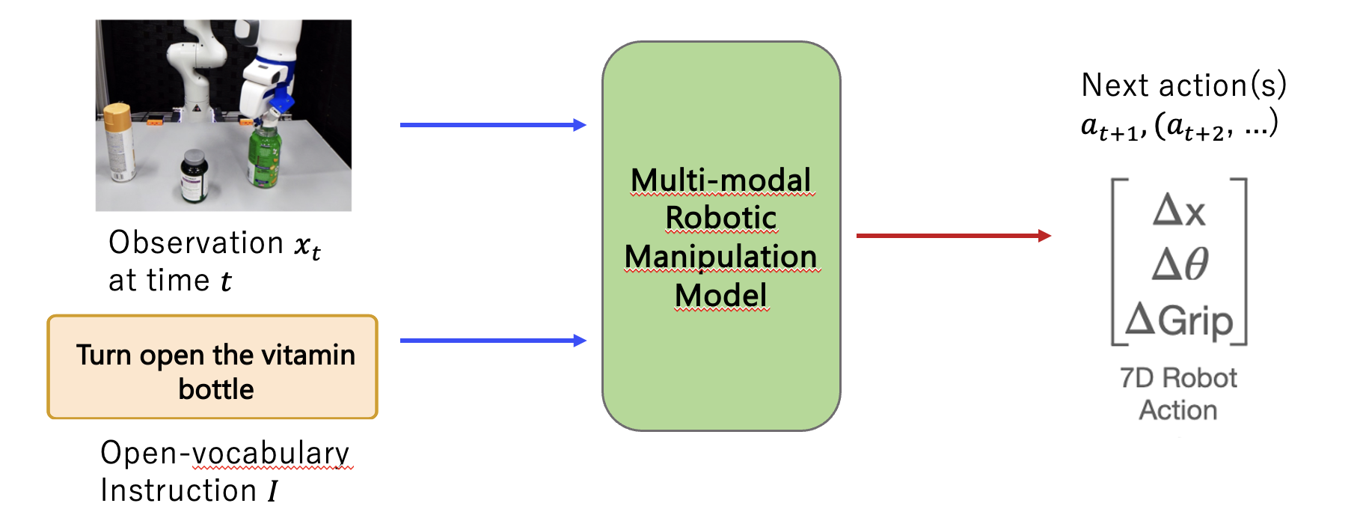
Problem Statement : From Open-vocabulary instruction and observations to actions
Current models are unable to generalize beyond their training data

Slide 5
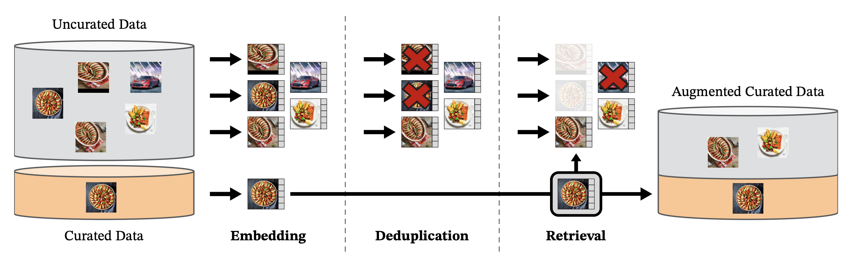
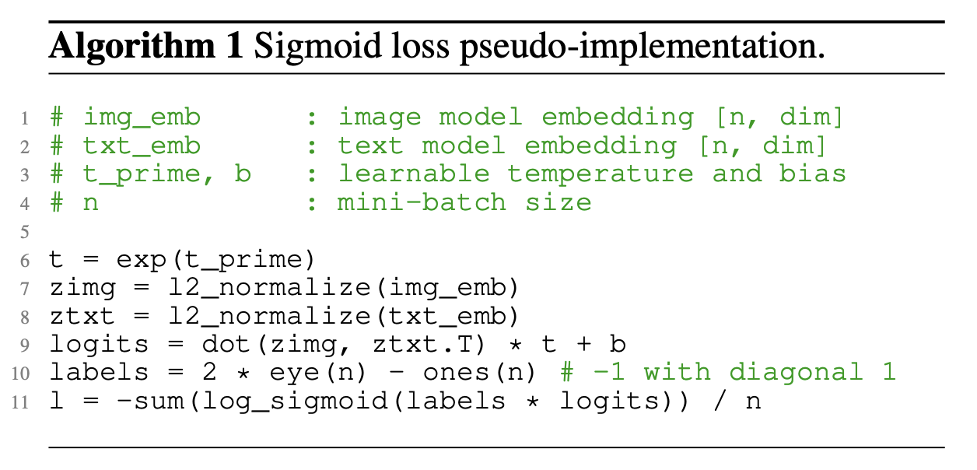
Related Works (1/2) : Visually-Conditioned Language Models
SigLIP [Zhai+, ICCV23] | Sigmoid loss for language-image pre-training, which demonstrates superior performance
DINOv2 [Oquab+, TMLR24] | Self-supervised learning scaled with large, curated datasets can produce general-purpose visual features.
DINOv2 [Oquab+, TMLR24]
SigLIP [Zhai+, ICCV23]

Slide 6
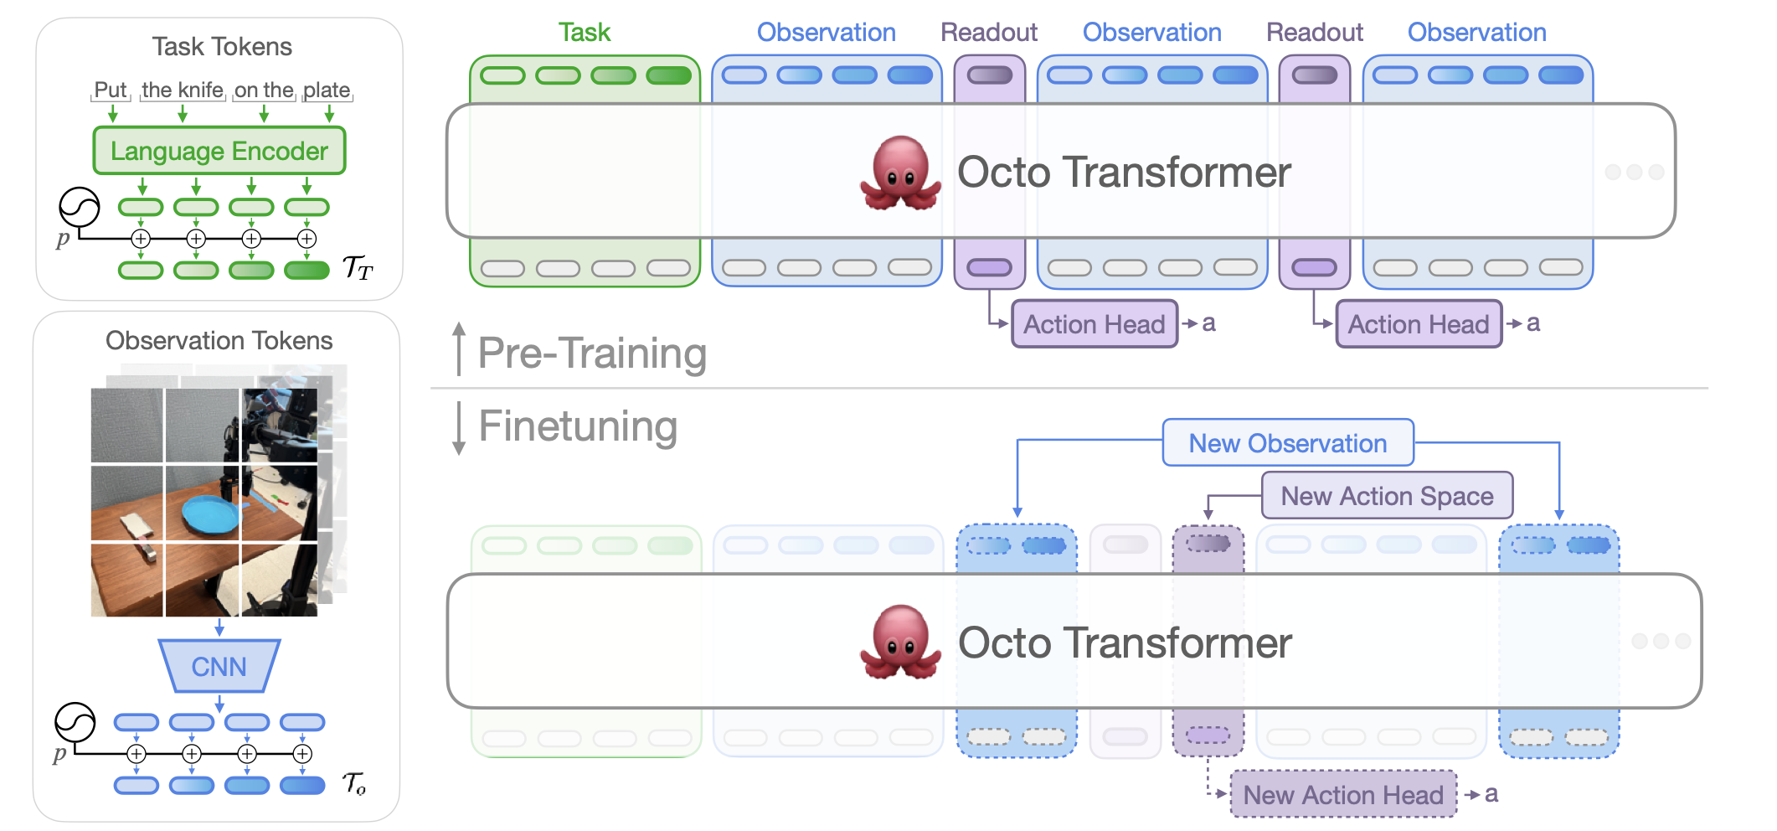
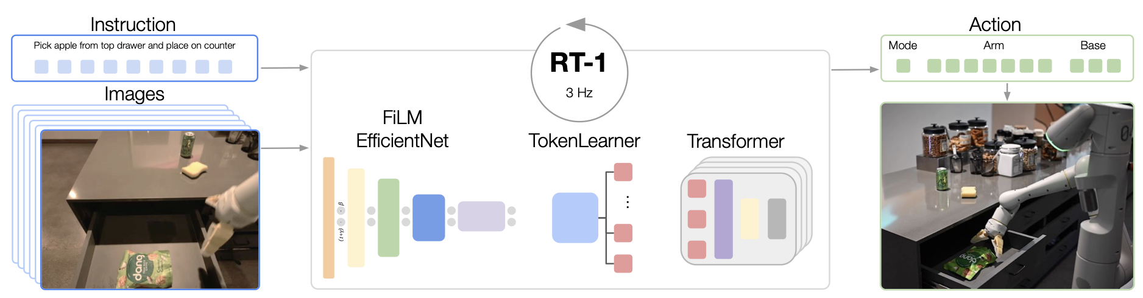
Related Works (2/2) : Generalist Vision-Language-Action models for robotics
RT-1 [Brohan+, arXiv22] | Scalable transformer-based model specifically designed for real-world robotic manipulation tasks.
Diffusion Policy [Chi+, RSS23] | Policy generation process involves denoising diffusion models.
Octo [Gosh+, RSS24] | Highly flexible architecture, making it a versatile tool for various robotic manipulation tasks.
RT-1 [Brohan+, arXiv22]
Octo [Gosh+, RSS24]

Slide 7
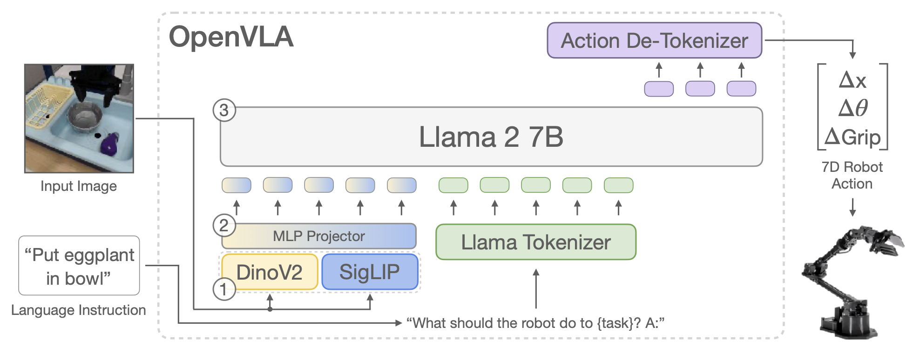
Proposed Method : The Open-VLA model architecture

Slide 8
Proposed Method : The Open-VLA model architecture
Inputs

Slide 9
Proposed Method : The Open-VLA model architecture
Visual encoder to create « image patch embeddings »

Slide 10
Proposed Method : The Open-VLA model architecture
A projector to map the embeddings into the input space

Slide 11
Proposed Method : The Open-VLA model architecture
A Large Language Model (LLM) backbone

Slide 12
Proposed Method : The Open-VLA model architecture
Continuous robot actions are mapped to the 256 least used tokens

Slide 13
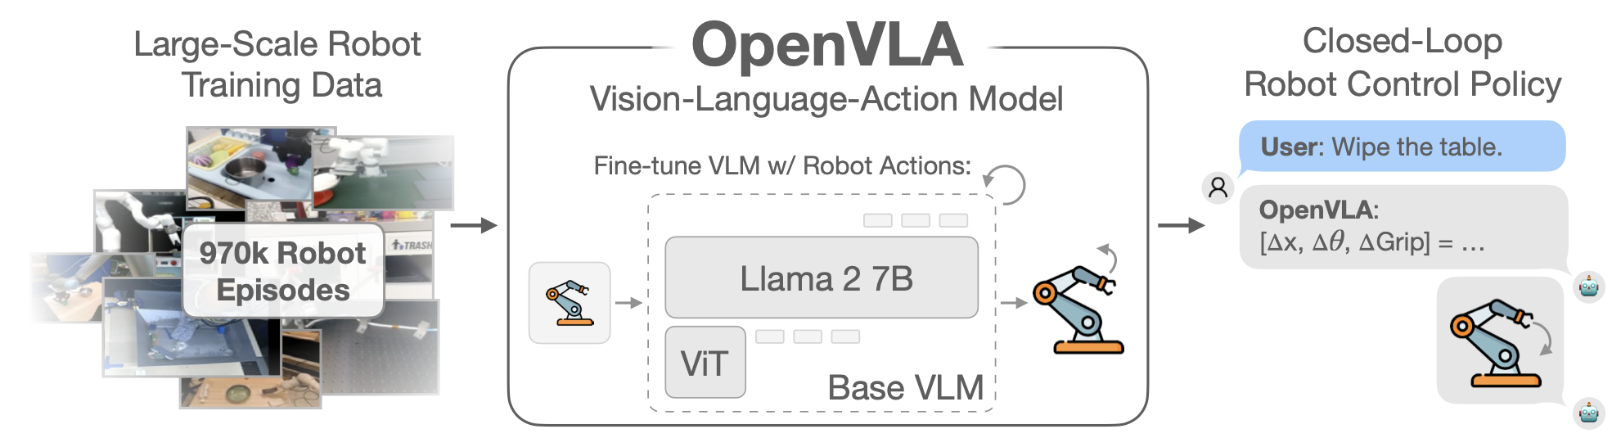
Proposed Method : Training procedure
Trained on :
Almost 1M Episodes
64 A100 GPUs for 14 days
27 epochs

Slide 14
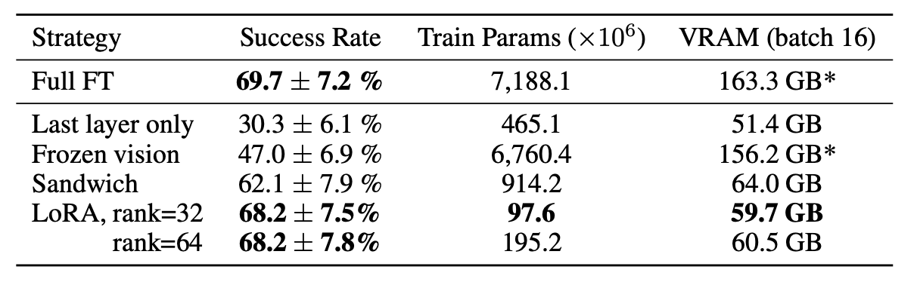
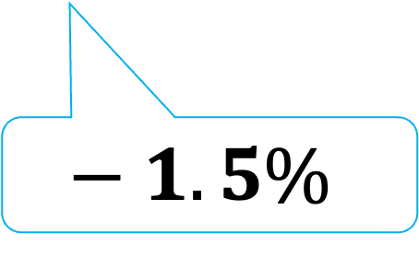
Proposed Method : Fine-tuning procedure
The full fine-tuning requires high computed
8 A100 GPUs for 5-15 hours
With LoRA, faster and the performances are almost equivalent
1 A100 GPU for 5-15 hours
$$− 1.5\%$$

Slide 15
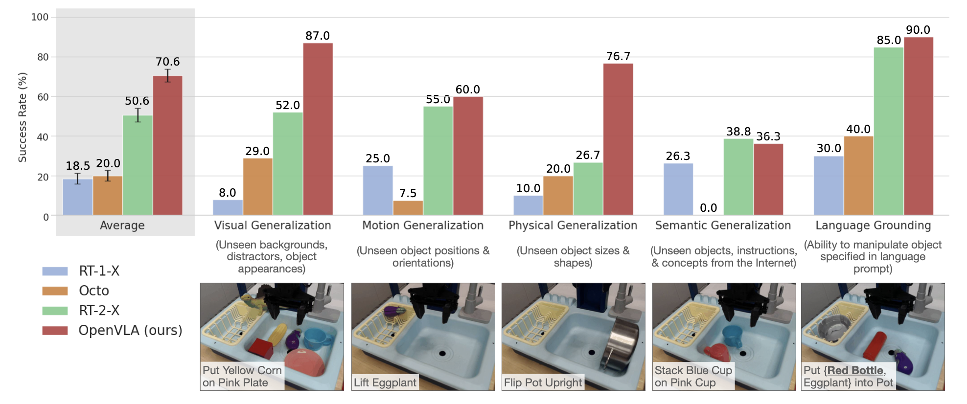
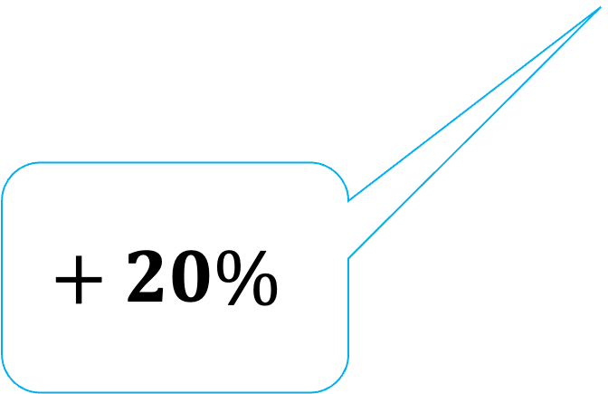
Quantitative results (1/2) : OpenVLA outperformed other methods on WindowX and Google robot
On WindowX robot with 10 trials on a total of 17 tasks
$$+ 20\%$$

Slide 16
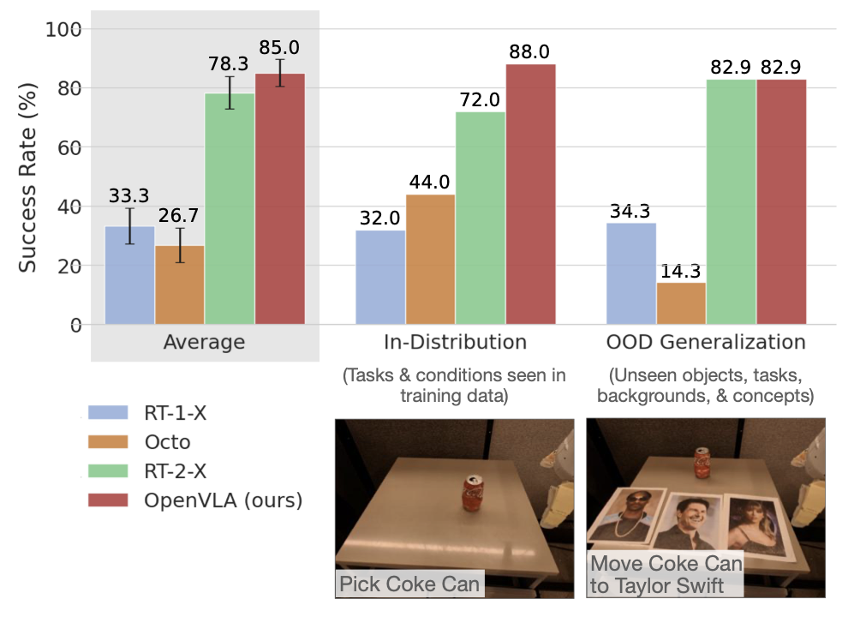
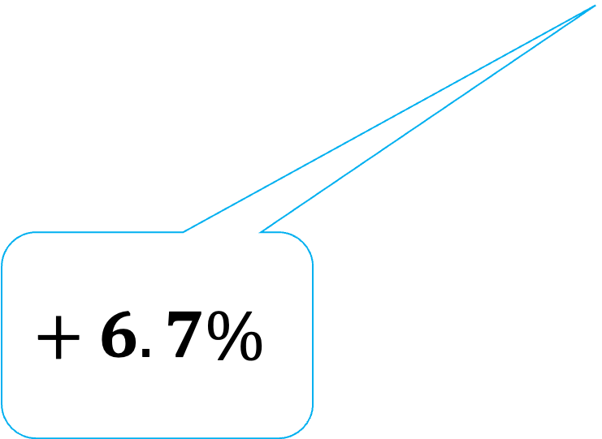
Quantitative results (1/2) : OpenVLA outperformed other methods on WindowX and Google robot
On Google robot with 5 trials on a total of 12 tasks
$$+ 6.7\%$$

Slide 17
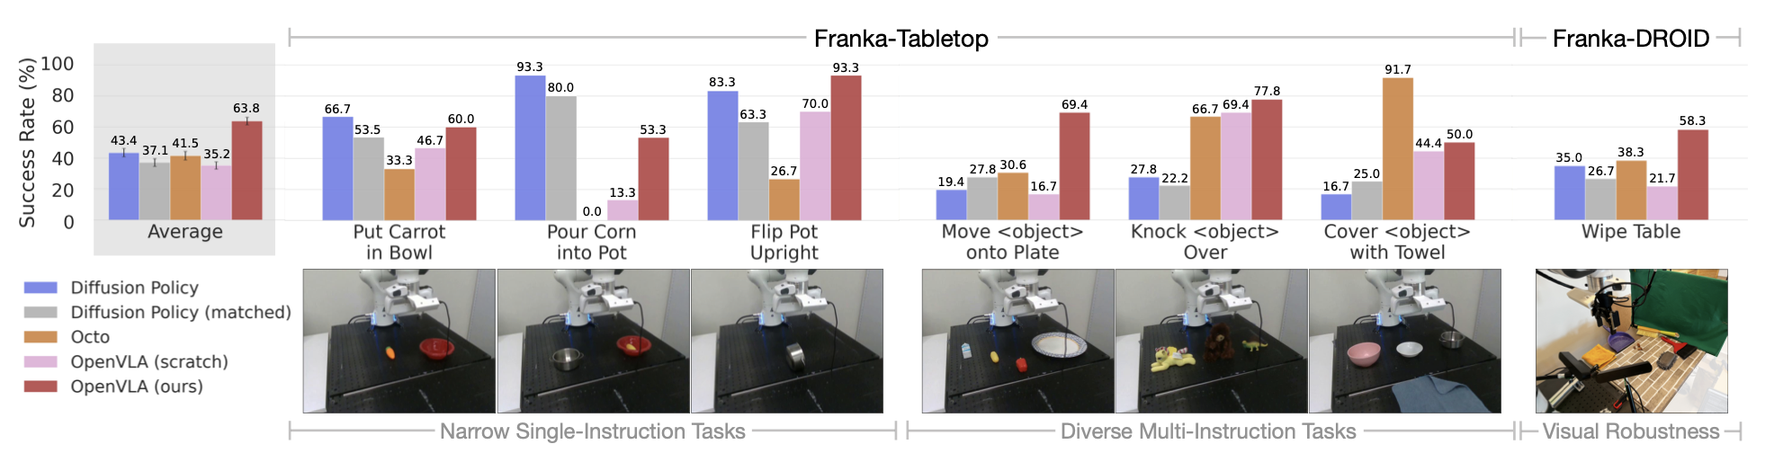
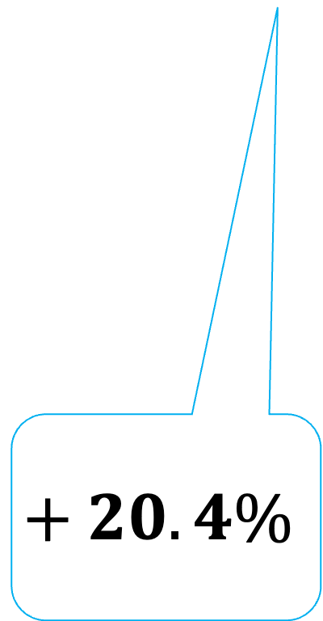
Quantitative results (2/2) : OpenVLA outperformed other methods when finetuned on new setups
On Franka-Tabletop and Franka-DROID with a total of 129 rollouts
$$+ 20.4\%$$

Slide 18


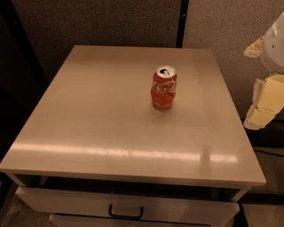
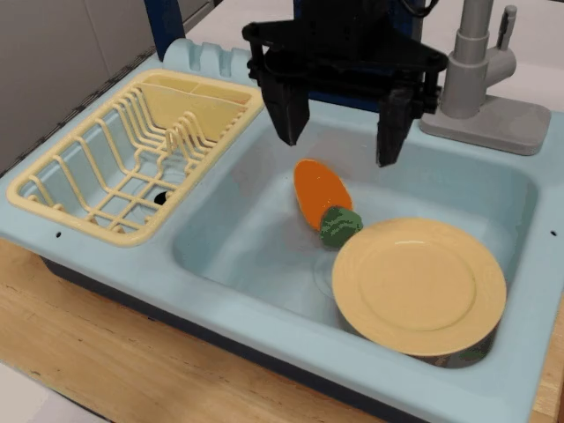
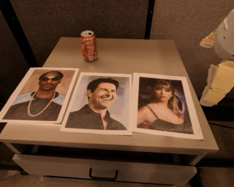
Qualitative results : OpenVLA perform reliably on in-distribution and basic out-of-distribution generalization tasks but struggle on unseen concepts.
Pick Coke Can
(In-Distribution)
Place Banana on Plate
(ODD : unseen target object and instruction)
Move Coke Can near Taylor Swift
(ODD : unseen concept from Internet)

Slide 19
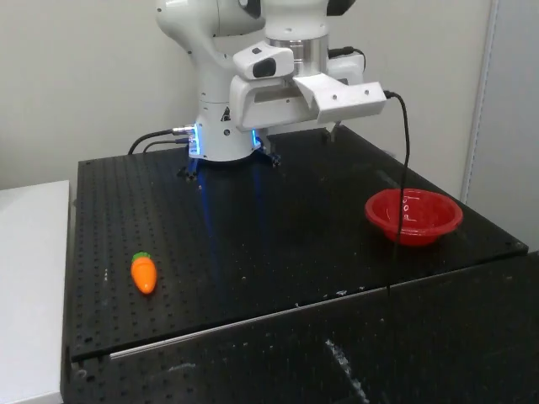
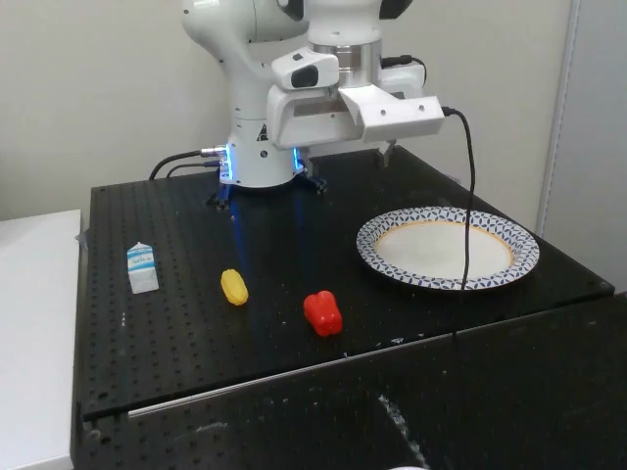
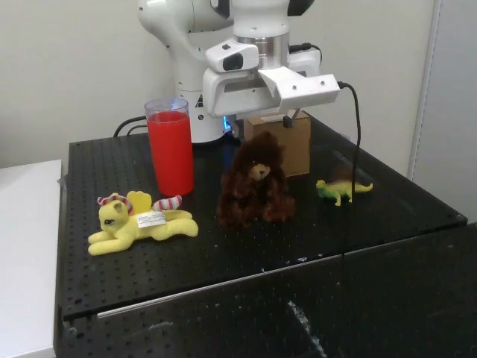
Qualitative results : OpenVLA perform poorly on narrow single-instruction fine-tuning tasks but perform better on multiple objects scenes
Put Carrot in Bowl
Move Yellow Corn onto Plate
Knock Brown Bear Over

Slide 20
Conclusion : A new approach to VLA models
OpenVLA – Open Source Vision-Language-Action Model:
State-of-the-art cross-embodiment robot control out-of-the-box
Can be easily adapted to new setups with fine-tuning
Limitations :
Only single image observations
Only single action output
Accuracy still < 90%
Future works :
Inspect size of the VLM on the performances
What visual features are best-suited for VLA models ?

Slide 21
My thoughts : A new step in making LLMs able to generate robotic actions
Strength:
Very innovative approach that leverages LLMs
Strong experimental results
Weakness :
Could have explained more about the motivations behind the architecture choices
Opinion:
Pave the way to create LLMs able of generating actions

Slide 22
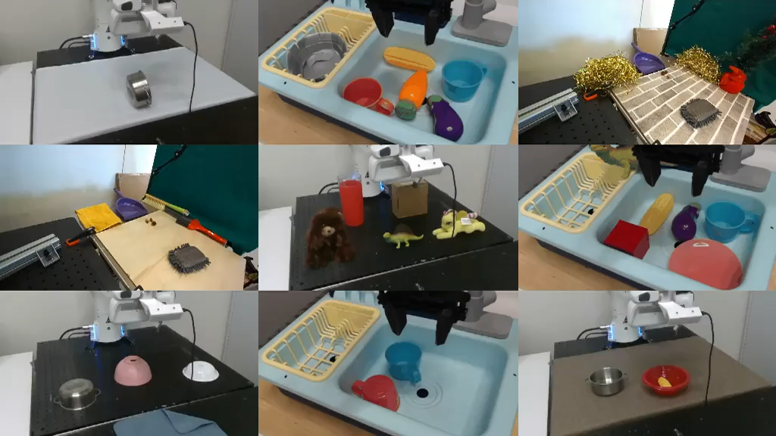
Summary : OpenVLA, an open-source Vision-Language-Action Model

